Slide 1
Phil 271 Spring 2017
Lecture 4

Slide 2
What we want to cover today
Finish the preliminaries for Kant and Mill.
Necessity, possibility, contingency
Relations of ideas/matters of fact
A priori and a posteriori truths
Analytic and synthetic truths
Rationalism and Empiricism
Kant on Mathematics
Mill’s version of empiricism

Slide 3
Necessity, Possibility, Contingency
Necessity/Possibility … “dual” concepts
Necessity comes in various flavors
Standard view: Mathematical truths are necessary truths
Is the standard view correct?
If it is, what flavor of necessity is it?

Slide 4
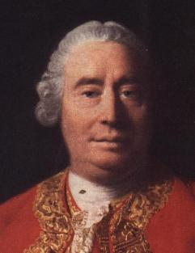
A strong claim … in disguise as a distinction
All the objects of human reason or enquiry may naturally be divided into two kinds, to wit, relations of ideas, and matters of fact. Of the first kind are the sciences of geometry, algebra, and arithmetic, and in short, every affirmation which is either intuitively or demonstratively certain. …
Propositions of this kind are discoverable by the mere operation of thought, without dependence on what is anywhere existent in the universe.
Matters of fact, which are the second objects of human reason, are not ascertained in the same manner; nor is our evidence of their truth, however great, of a like nature with the foregoing. The contrary of every matter of fact is still possible, because it can never imply a contradiction, and is conceived by the mind with the same facility and distinctness, as if ever so conformable to reality.
David Hume, 1772

Slide 5


A priori/A posteriori

Slide 6

Analytic/Synthetic
Kant introduced this terminology, though the idea predates him.
Two ideas that Kant thought amounted to the same thing:
In affirmative judgments: “Either the predicate B belongs to the subject A as something that is (covertly) contained in this concept A; or B lies entirely outside the concept A, though to be sure it stands in connection with it. In the first case, I call the judgment analytic, in the second synthetic.”
How do we tell if a claim is analytic? Shapiro discusses the “chemical” metaphor. But Kant also suggests:
“I merely draw out the predicate in accordance with the principle of contradiction, and can thereby at the same time become conscious of the necessity of the judgment.”

Slide 7
Rationalism and Empiricism
 | A priori | A posteriori
Analytic | “Relations of ideas” for Hume | No such thing, in opinion of pretty much everyone before Saul Kripke in the 20th Century
Synthetic | Empiricsts say there are none of these Rationalists think there are some … | Matters of fact for Hume

Slide 8
Kant and prior Rationalists
Recall Hume’s account of “relations of ideas,” but let’s emphasize something different: Propositions of this kind are discoverable by the mere operation of thought, without dependence on what is anywhere existent in the universe.
Previous Rationalists (Plato, Descartes, Spinoza, Leibniz) thought we could discover (to varying degrees) facts about “what exists” purely a priori
For us, the distinctive Kantian claim is that mathematics is synthetic but knowable a priori

Slide 9
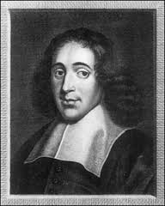
Example of prior Rationalists: Spinoza
Spinoza explicitly modeled his work on Euclid …
Axioms
A1: The essence of man does not involve necessary existence; whether this or that man exists or doesn’t exist depends on the order of Nature· and not on the man’s essence
A2: Men think.
A3: Whenever there is a mental state such as love, desire, or anything else that can be called an ‘affect’ of the mind, the individual who has it must also have an idea of the thing that is loved, desired, etc. But the idea can occur without any other mental state, and thus without any corresponding and immoderate desires (such as ambition). All they have in common is their tendency to influence human conduct, mostly for the worse.
A4: Each of us feels that a certain body is affected in many ways.
A5: We neither feel nor perceive any particular things except bodies and modes of thinking.

Slide 10
E.g. of Rationalist thinking … Spinoza
From these supposedly self-evident axioms, Spinoza “derives” propositions that are clearly synthetic … to give just one instance …
Prop. XVIII. Desire arising from pleasure is, other conditions being equal, stronger than desire arising from pain.
Proof.- Desire is the essence of a man (Def. of the Emotions, i.), that is, the endeavour whereby a man endeavours to persist in his own being. Wherefore desire arising from pleasure is, by the fact of pleasure being felt, increased or helped; on the contrary, desire arising from pain is, by the fact of pain being felt, diminished or hindered; hence the force of desire arising from pleasure must be defined by human power together with the power of an external cause, whereas desire arising from pain must be defined by human power only. Thus the former is the stronger of the two. Q.E.D.

Slide 11
Kant, for starters (more next week)
If mathematical truths are synthetic a priori, they are not logically necessary (or else they’d be a priori)
In places, that mathematical truths are not logical truths is the reason he gives for saying they’re not analytic
Since synthetic, they must be based on non-conceptual information … something like perception. Kant calls this intuition.
But it is because they are necessary truths that the cannot be a posteriori
Claims only knowable based on empirical/inductive methods are never necessarily true
What sort of necessity does Kant have in mind?
So mathematics can’t be based on information from the physical senses (“sensible intuition”)
So … mathematical knowledge must be based on a non-sensible sort of intuition; this sometimes gets called “mathematical intuition”

Slide 12
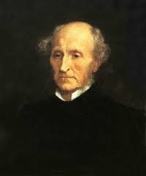
Mill: empiricist maximus
Hume, other early empiricists, regarded mathematics as merely “relations of ideas” … both analytic and a priori
The other option for an empiricist is to put mathematics in the same category as the empirical sciences, namely as “matters of fact” that are a posteriori and synthetic
So: 2 + 2 =4, for instance, is not necessarily true, it’s just a very strongly confirmed hypothesis.
So: it’s not incoherent to think 2 + 2 sometimes does not yield 4; it’s just hard to imagine because we so often see it turn out to be 4

